Slide 1
Project On A WEB APPLICATION FOR TOURISM MANAGEMENT SYSTEM

Slide 2
Content: Introduction Problem Solution Screenshot Frontend Backend Data Flow Diagram ER Diagram Software requirement future scope conclusion

Slide 3
AIM OF PROJECT
The main purpose of the project “ Tourism management” is to provide a convenient way for a customer to book hotel, flights, train and bus for tour purpose.
The objective of these project is:-
1. To develop a system that automate the processes and activities
of a travel agency.
2. In these project we will make an easier task of searching place and for booking train, flight or bus.

Slide 4
Objectives:
This application is develop to provide best travelling services to the customers and travel agents. We have developed tours and travel management system to provide a search platform where a tourist can find their tour places according to their choices. This system also helps to promote responsible and interesting tourism so that people can enjoy their holidays at their favorable places. This system also helps to develop tourism with different cultures so that they enrich the tourism experience and build.

Slide 5
:
people in this world like to travel from one place to another no matter whether it is small or large distance. The need for a tourism management system that can manage tourism information with ease is sought after by every tour management company. Tour management system is a dynamic website for tourism business. this travel and tourism application is designed for travel agencies by which they can manage different tourism package based on the destinations. By using this the tour company can tailor tour packages spanning various destination at almost every price point. They also implement search module allow the administrator to find and update or upgrade the tour packages with ease. This module can also even be extended to customer application page by which customer can find the right tour packages for them at every budget depending on the tour locations. The main purpose is to help tourism companies to manage tour package.

Slide 6
Problems
Tourism often puts pressure on Resources through over- consumption often in places where resources are already scarce.
We need a strong database whereas data will be store for everyone.
Taxation:- tourism is one of the sector that government heavily tax.
Cost cutting on business travel expenses.

Slide 7
Solution statement :To address all the mentioned problem the website has been developed, nearly everyone goes on vacation and tourism management would play a vital role in planning the perfect trip.

Slide 8
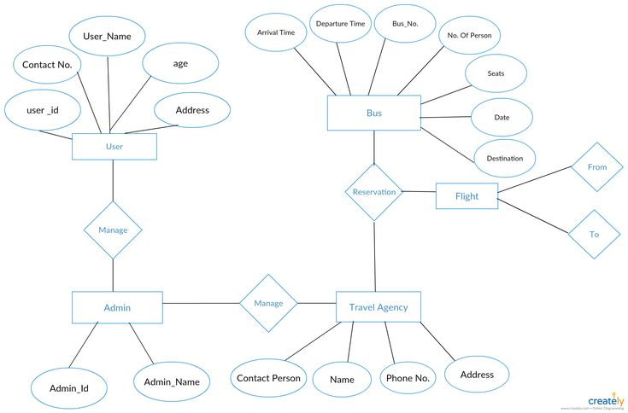
ER DIAGRAM:-

Slide 9
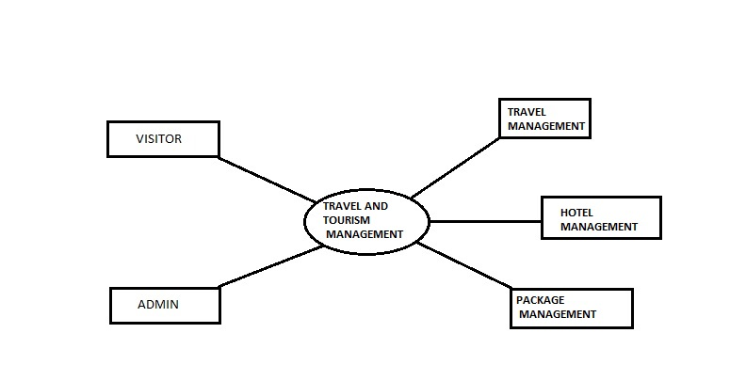
Data flow diagram(0 level)

Slide 10
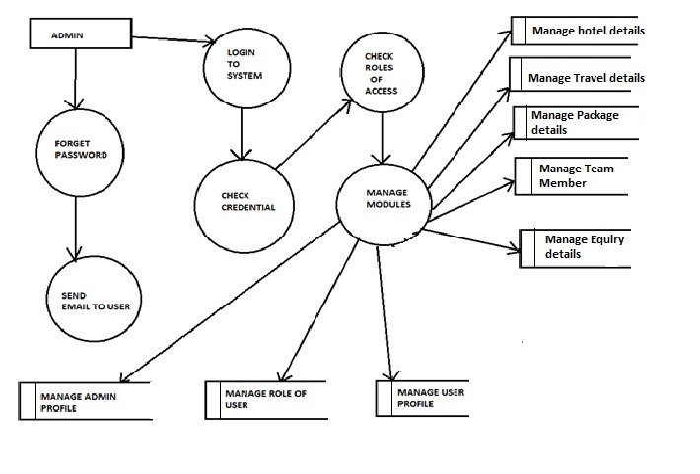
Data flow diagram(1 level)

Slide 11
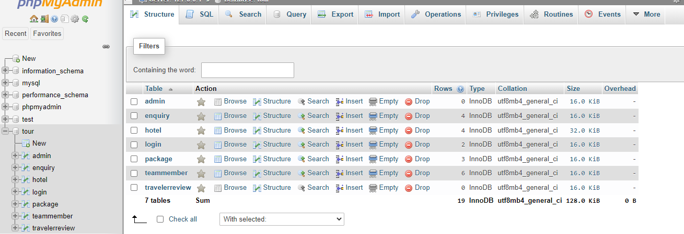
DATABASE TABLE:-

Slide 12
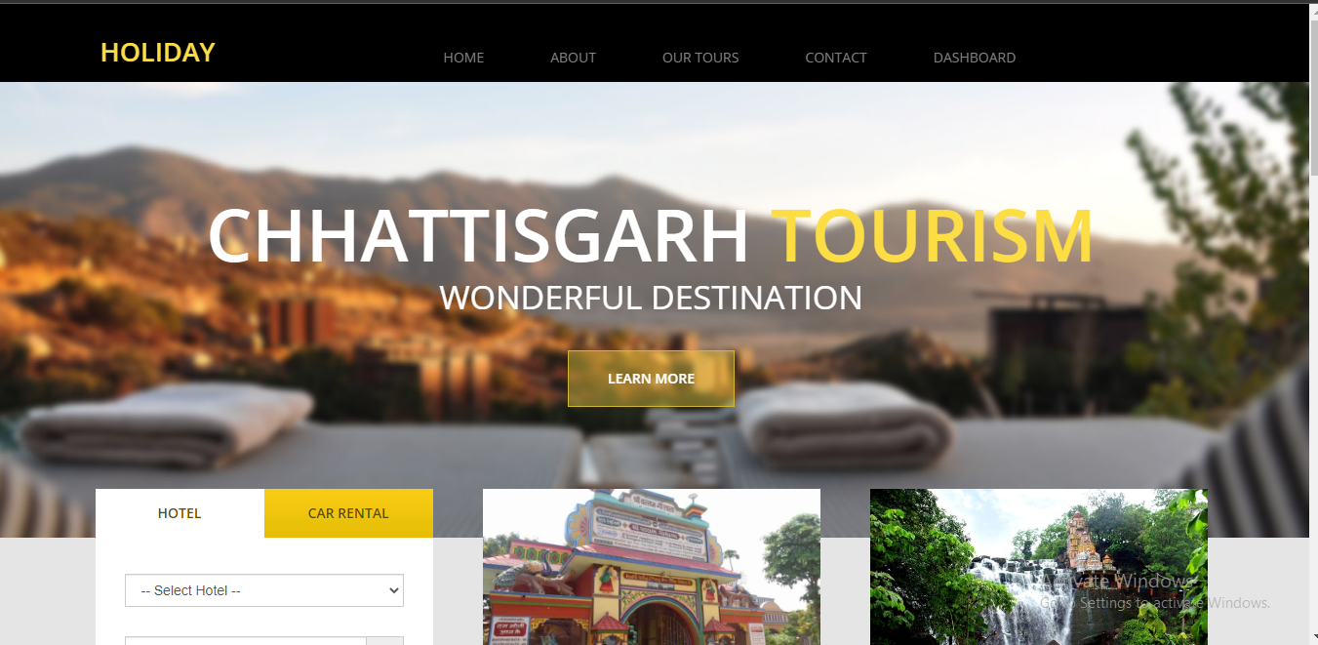
Screenshot:-
HOME PAGE

Slide 13
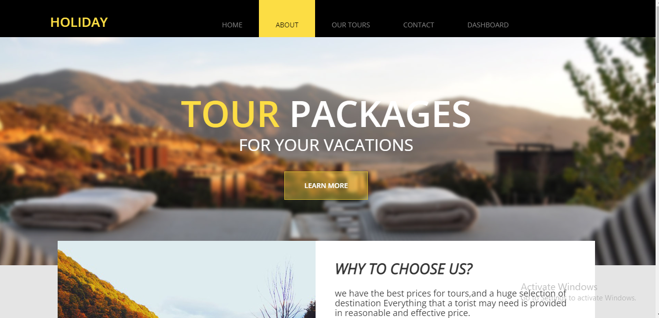
ABOUT US:

Slide 14
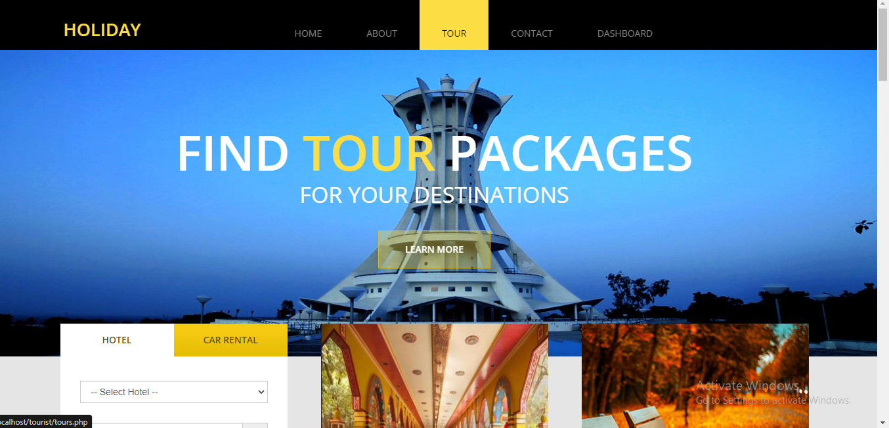
TOUR

Slide 15
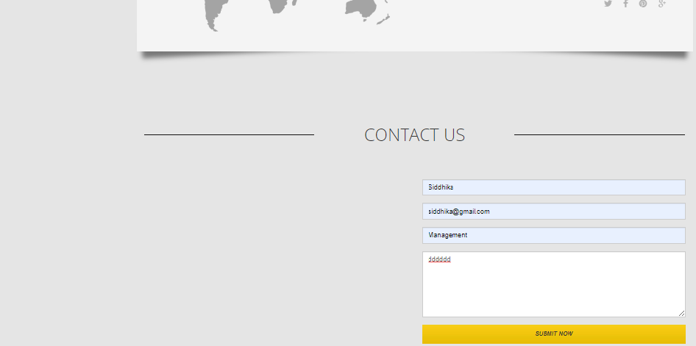
CONTACT US

Slide 16
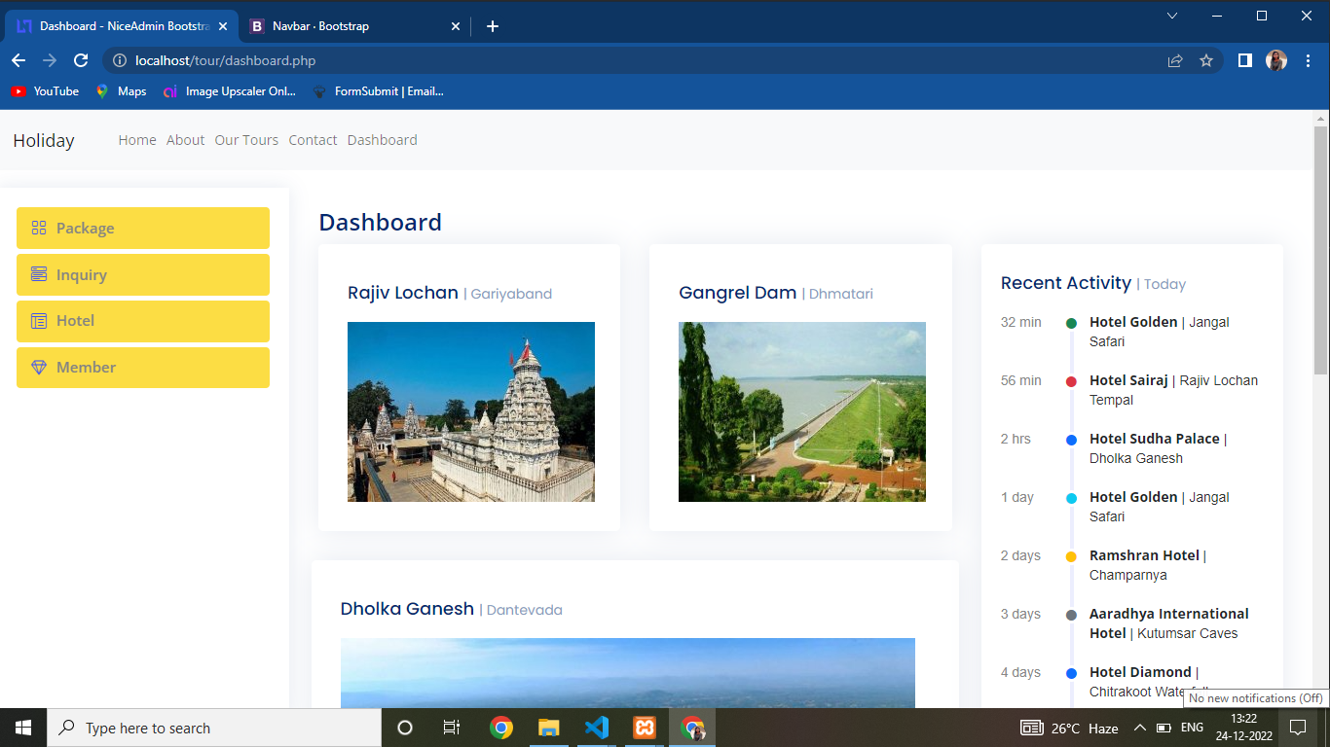
Dashboard

Slide 17
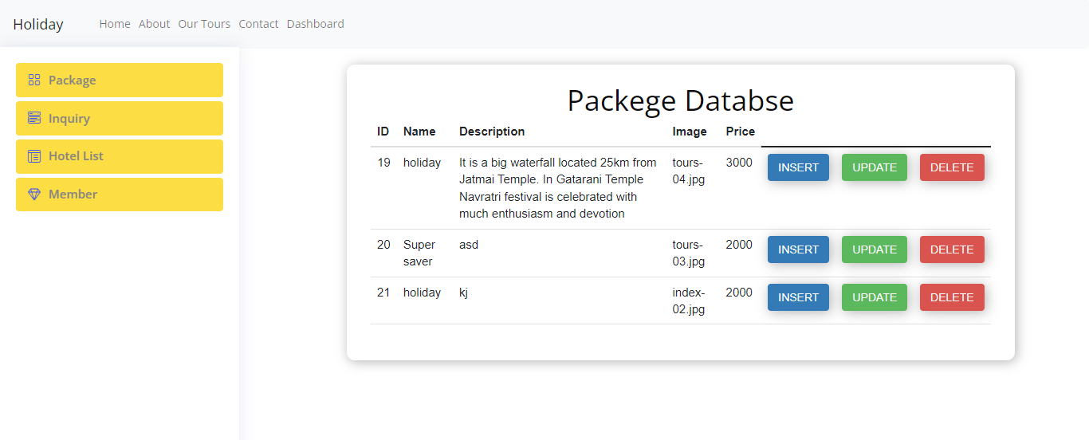
Package

Slide 18
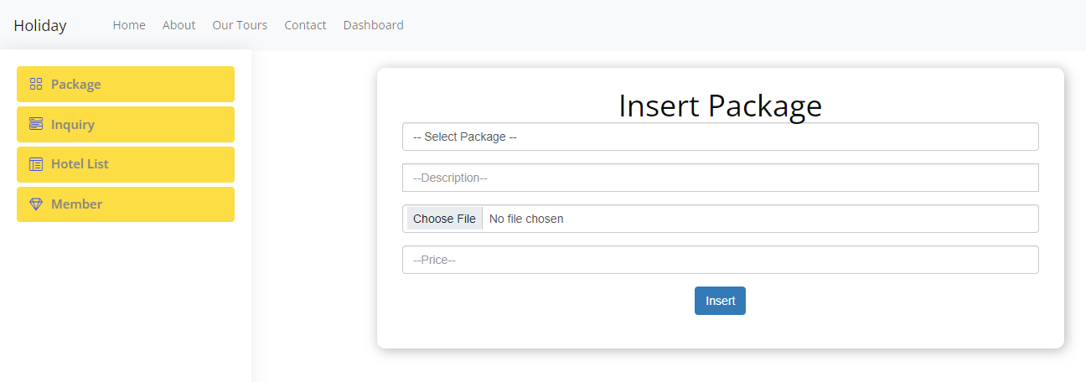
Insert Package

Slide 19
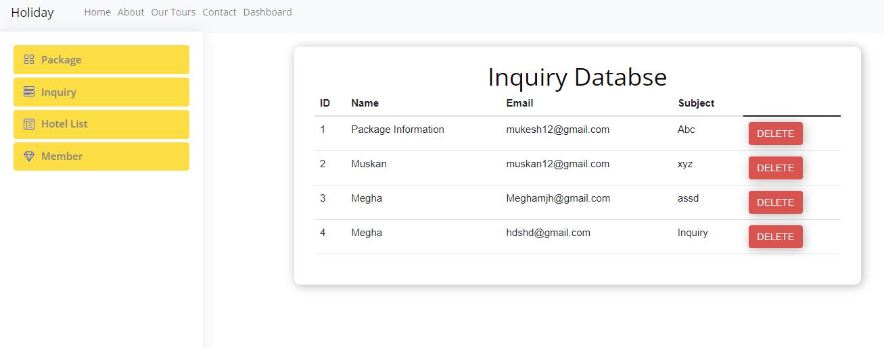
Enquiry

Slide 20
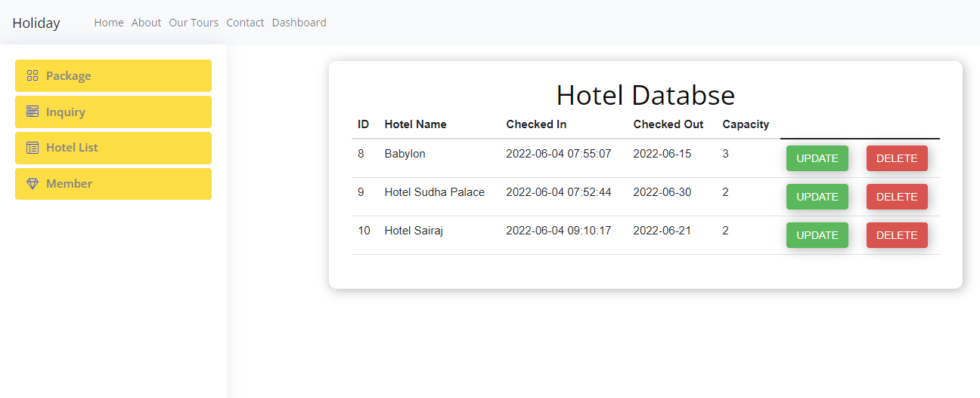
Hotel List

Slide 21
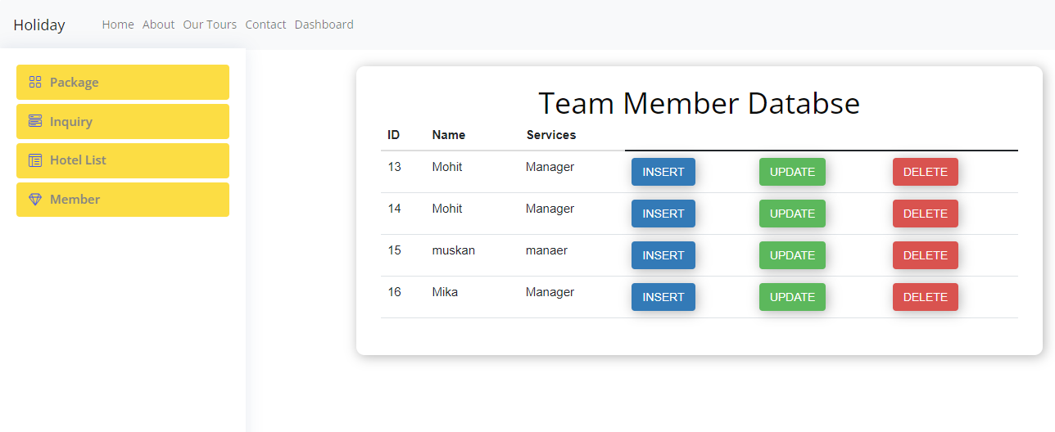
Dashboard

Slide 22
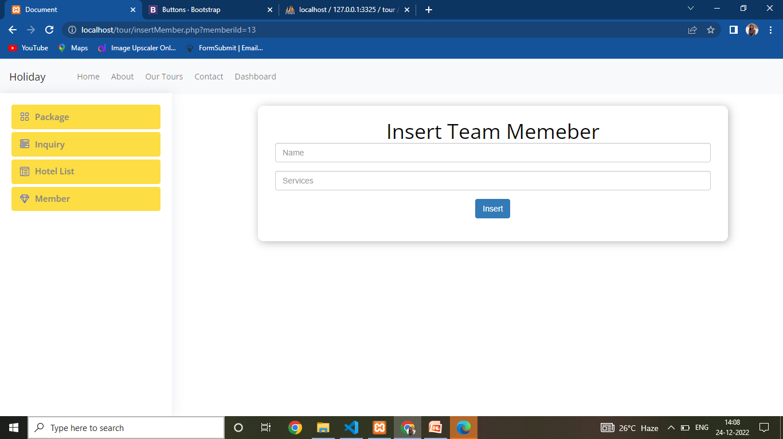
Insert Memeber

Slide 23
NEED OF THIS WEBSITE:-TOURISM IS VITAL FOR THE SUCCESS OF MANY ECONOMIES AROUND THE WORLD”. Tourism boosts the revenue of economy, creates thousand of job, infrastructure of a country. Hence tourism website influence tourist perceptions and impressions which significant determines their plans to visit a destinations.

Slide 24
Software Requirements: minimum software requirements: Front End: Html(5), JAvascript Scripting: Php Backend : Mysql

Slide 25
The web applications involves allmost basic features of online tour and travel management system .The future implementation will be on online help for the users and chatting with website administrator.
Future scope:

Slide 26
Conclusions:
Tourism is currently recognized as a global industry which is growing at a high rate like any other industry. Access to relevant and accurate information is at the heart of tourism. Here, the proposed project on Tourism Management System tries to bridge the gap by noting what a tourist perceives as relevant. Hence, the aim of this project entails the design and implementation of a platform that will assist tourists in gaining access to travel to various tourist locations. The project also helped to provide knowledge about the latest technology used in developing web enabled application and client server technology that will be great demand in future.

Slide 27
THANK YOU

